Slide 1
OIC Temperature Sensor

Slide 2
OIC Temperature Sensor
Application Area: The integrated-optic temperature sensor requires no electrical connection, making it particularly useful in explosive or flammable environments in which an electrical sensor might be dangerous.

Slide 3
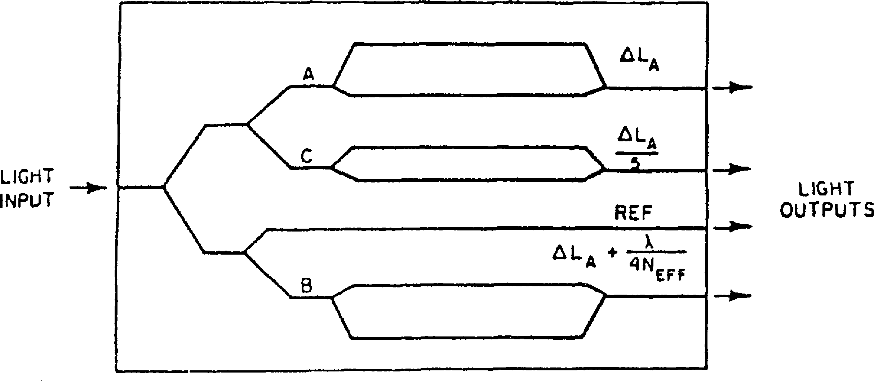
OIC Temperature Sensor
Construction: The OIC is fabricated in a LiNbO₃ substrate with Ti diffused waveguides. It features a parallel array of three unequal arm-length Mach-Zehnder interferometers.

Slide 4
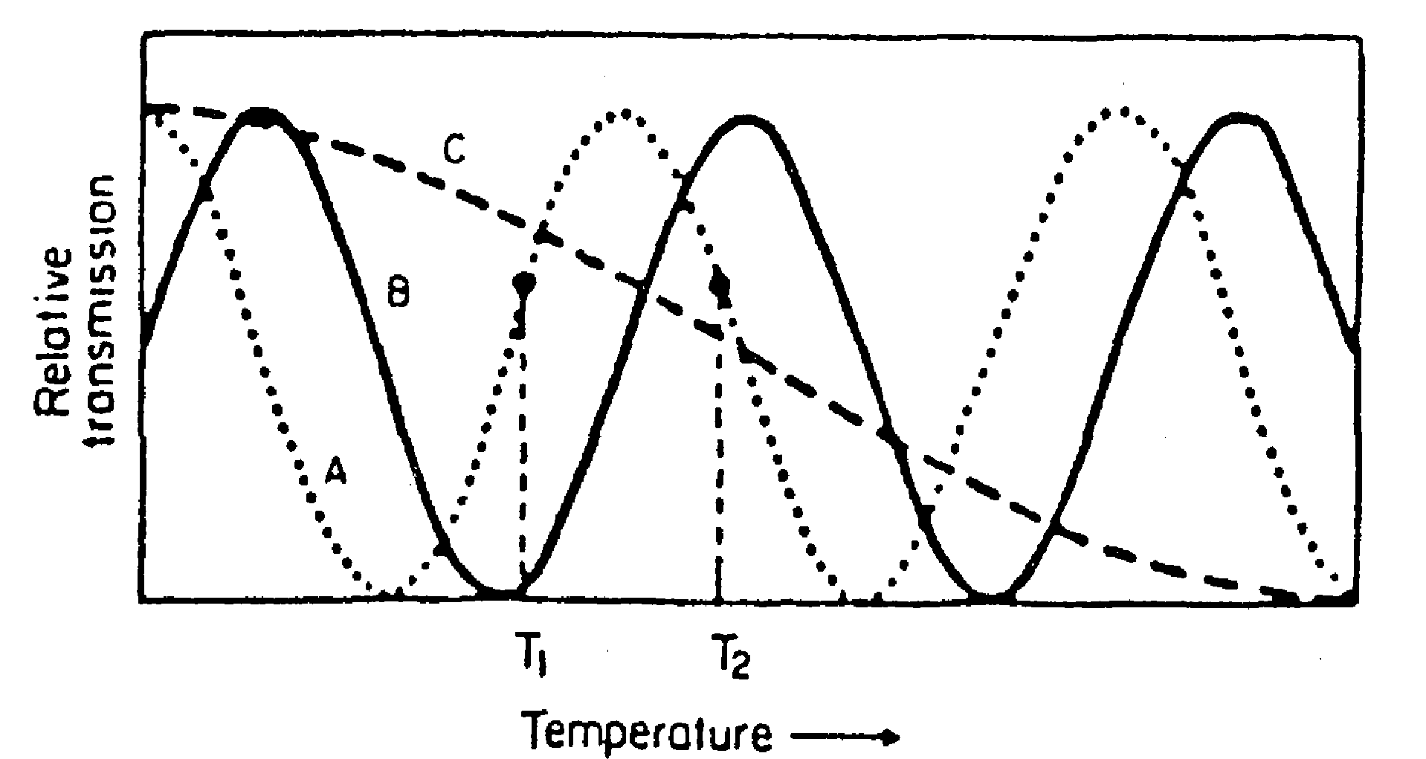
OIC Temperature Sensor
Operation: The optical transmission of each interferometer varies sinusoidally with temperature with a period which is inversely proportional to the optical path length difference between the two arms.

Slide 5
The optical transmission P_{out}/P_{in} at the wavelength λ depends on both the effective index n_{eff} and the path length difference ΔL and is given by
where the constant of proportionality b is given by
Both n_{eff} and ΔL are functions of temperature T. The quantities γ and m are related to the insertion loss and depth of modulation of the interferometer, respectively.
(For an ideal device γ = m = 1.0.) Δϕ₀ is a constant for a given device.

Slide 6
By measuring the transmission of all three interferometers one can determine the temperature.
Two of the interferometers (A and B) have arm-length differences that are almost the same.
Thus their transmission curves track close to one another, providing a high resolution in the temperature measurement.
The third interferometer (C) has an arm-length difference which is only approximately one-fifth those of A and B.
Thus one can determine which peak of the A and B transmission curves is being measured and temperature measurements can be made over a wide range.

Slide 7
Accuracy:
It has been reported that this temperature sensing OIC can measure with an accuracy of 2 × 10⁻³ °C over a 700 °C range, when used with a 632.8 nm He-Ne laser as the light source.
The sensor, of course, would be mounted at the point at which temperature measurement was desired and the optical input and output would be via optical fiber.
Advantages:
Since the OIC chip is about 1 cm on a side, temperature measurements can be made on relatively small objects.
Since the measurement signal is entirely optical, this device is relatively immune to electrical noise.

Slide 8
IO High Voltage Sensor

Slide 9
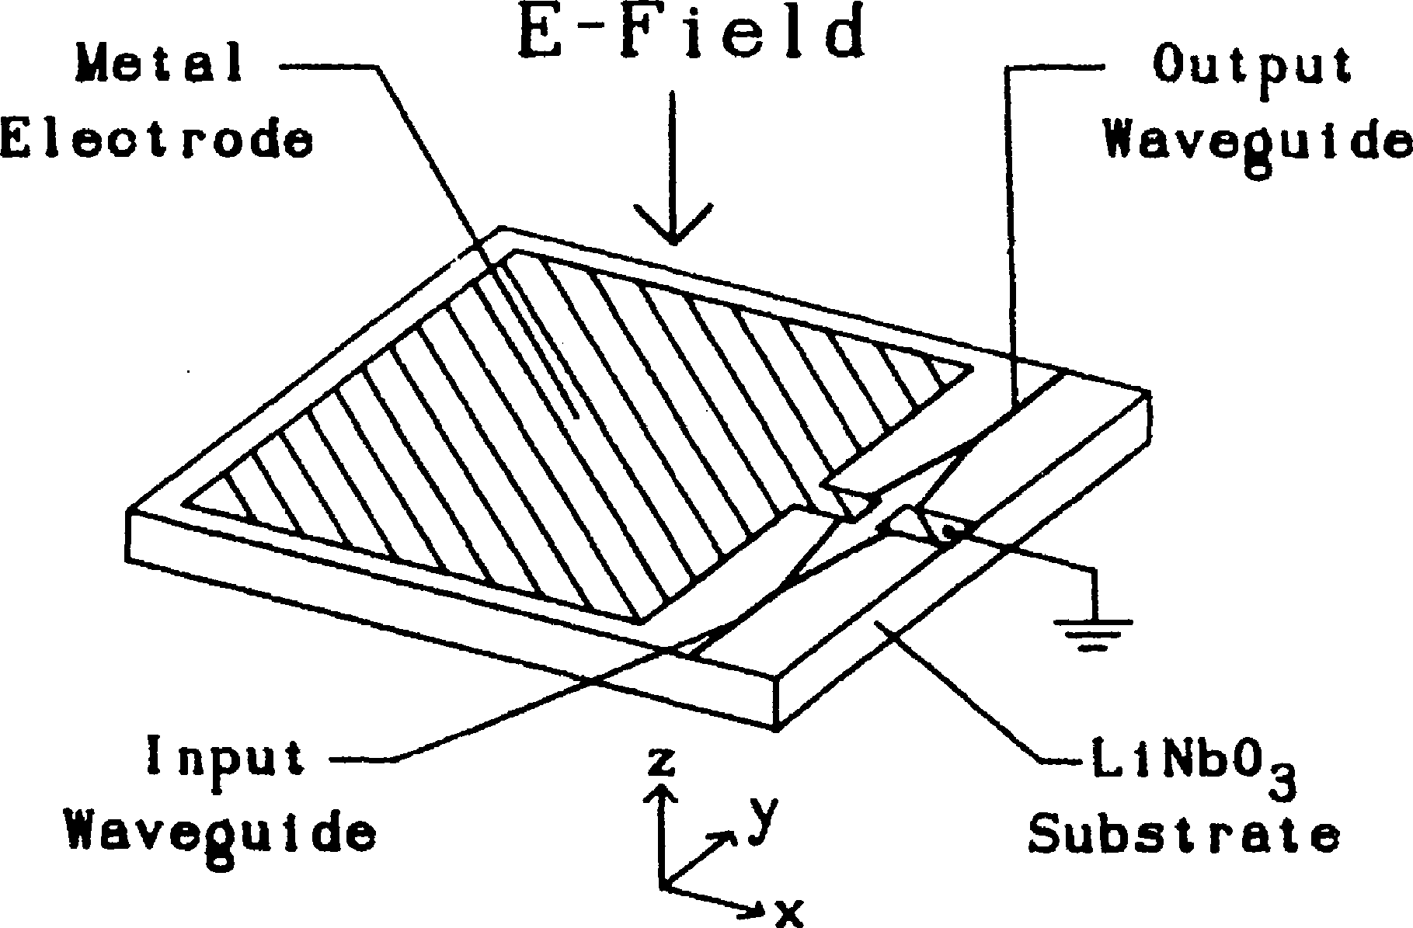
IO High Voltage Sensor
Integrated-optic Mach-Zehnder interferometers can be used to sense high voltage as well as temperature.
A diagram of an IO High Voltage Sensor is shown in Fig

Slide 10
IO High Voltage Sensor
Construction:
The waveguides are formed by Ti diffusion into a LiNbO₃ substrate.
In this circuit the two branches of the interferometer are covered by metal electrodes which form a capacitive voltage divider.
The electric field generated by the high voltage source induces a voltage on these electrodes which causes a relative phase shift between the optical waves in each arm, resulting in an intensity modulation of the output beam.

Slide 11
IO High Voltage Sensor
The voltage-in/optical power-out transfer function is given by
where P_{in} is the input power,
ϕ_{i} is the intrinsic or zero voltage phase difference.
V is the applied voltage
V_{π} is the half-wave phase shift voltage.
The constants α and γ must be determined for a particular device. (For a perfect device α = γ = 1.0.)
Once the calibration curve has been determined for a particular sensor, the voltage can be accurately measured.

Slide 12
IO High Voltage Sensor
Advantages:
Since this sensor operates on the principle of an induced voltage it is not necessary to make electrical contact to the high voltage source, and input to, and output from the sensor can be via optical fiber.
Thus good high voltage isolation can be maintained. The immunity to electrical noise provided by an optical fiber link is also a particularly important advantage when operating in a high voltage environment.
Applications:
This integrated optical high voltage sensor could be used, for example, for monitoring line voltages in SF6-gas insulated bus ducts such as are used in power plants and switching stations.

Slide 13
IO Chemical Sensor

Slide 14
IO Chemical Sensor
Intro: Integrated optic devices can be used to sense the presence and the concentration of various chemical elements.
How? These sensors generally function by measuring the change in some optical property of the material in a waveguide that is produced by the presence of the chemical to be sensed.
Tools required: Both absorption spectrophotometry and attenuated total reflection spectrometry can be used, as well as fluorescence spectrometry.
Waveguide Type: The waveguide may be either an optical fiber or a multilayer guide in an OIC.

Slide 15
IO Chemical Sensor
An example of this type of sensor is the thin-film polyvinyl chloride (PVC) co-polymer sensor
When doped with (HDOPP-Ca), a neutral ionophore for calcium, dioctyl phthalate (DOP), and the chromoionophore (ETH5294) the PVC waveguide showed enough chemical reaction to the Ca²⁺ ion to measure its concentration when the waveguide was brought in contact with a solution of CaCl₂.
The absorption characteristics of the doped PVC waveguide in the range from 500 to 700 nm are changed by the presence of Ca²⁺, causing a reduction in absorption and a shift of the peak to shorter wavelength.
These changes can be calibrated with respect to calcium concentration. The use of different dopants can be expected to make the waveguide sensitive to the ions of other elements.

Slide 16
Monolithic Wavelength-Multiplexed
Optical Source

Slide 17
Monolithic Wavelength-Multiplexed Optical Source
Introduction: In an optical-frequency-multiplexed transmitter, a number of DFB lasers, operating at different wavelengths, are coupled into a single fiber transmission line.
An OIC of this type has been fabricated by Alki et al. using GaAlAs monolithic technology.

Slide 18
Construction:
Six DFB lasers, operating at wavelengths separated by 2 nm , were fabricated on a 5 mm square GaAs substrate by a two-step LPE growth process. The lasers had a separate confinement Heterostructure (SCH).
Third-order gratings were made on the surface by chemical etching, by using a mask made by holographic lithography. The lasers were coupled to undoped Ga_{0.9}Al_{0.1}Aswaveguides by direct transmission.
The lateral dimensions of the lasers and waveguides were denned by mesa etching down to the GaAs substrate to produce stripes that were 20 μm wide and 3 μm thick.
The separation of the lasers was 300 μm, and the waveguides were curved through bends of minimum radius equal to 4 mm, in order to bring them together in a confluent coupler
The output of the coupler was obtained via a single waveguide that was butt coupled to an optical fiber.

Slide 19
Monolithic Wavelength-Multiplexed Optical Source
DFB laser coupled to a GaAlAs waveguide by direct transmission

Slide 20
Monolithic Wavelength-Multiplexed Optical Source
Schematic drawing of a wavelength-multiplexed light source

Slide 21
Monolithic Wavelength-Multiplexed Optical Source
Operation:
The lasers were operated by applying 100 ns current pluses at a repetition rate of 1 kHz.
No difficulty was encountered in separately modulating the six lasers, and the overall differential quantum efficiency, measured at the launching output terminal, was about 30%.
Work on monolithic wavelength-multiplexed optical sources employing DFB lasers has continued over the years, with more recent work being directed toward 1.3 μm and 1.55 μm wavelength lasers for optical-fiber telecommunication systems.
In order to be cost effective, it is necessary to fabricate multi-wavelength laser transmitters by monolithic integration on one chip to reduce the cost of packaging and control circuitry by sharing them among all of the wavelengths.
Sl. No | Laser Parameters | Optimized Values
1 | Differential Quantum Efficiency | 7%
2 | Waveguide loss coefficient | 5 cm⁻¹
3 | Threshold current densities (at room temperature) | 3 to 6 kA/cm²
4 | Wavelength separation between lasers | 20± 5 A°

Slide 22
Ex. 1: Frequency-division multiplexed ten-channel tunable DFB laser array
The lasers are tunable, multi-section, quarter-wave-shifted, strained InGaAsP MQW devices.
The lasing frequencies of channels are spaced within a 10 GHz range. The linewidth of each channel is less than 2.3 MHz.
Schematic diagram of a ten channel tunable DFB laser array. The laser is as multi section λ/4 shifted DFB-BH laser with AR coated facets.

Slide 23
Ex. 2: Monolithically integrated chip containing 21 DBR lasers
They used sampled grating distributed Bragg Reflectors, in which the grating is not continuous, but rather is formed in bursts so that it has two inherent periodicities.
This type of DBR grating makes the selection of laser emission wavelength more accurate.
The 21 InP/InGaAsP MQW lasers on the chip had emission wavelengths spanning over 40 nm with 0.8 nm spacing, centered at approximately 1.56 μm.
Schematic of SGDBR laser arrays.

Slide 24
Analog – to – Digital Convertor (ADC)

Slide 25
Analog – to – Digital Convertor (ADC)
An analog-to-digital conversion method in an optical integrated circuit that is capable of one-bit electro-optical AD conversion at a 100 MHz rate is given in the Fig.
Diagram of an integrated-optic analog to digital converter

Slide 26
Analog – to – Digital Convertor (ADC)
Construction:
The OIC incorporates two 3-dB couplers and a phase shifter, formed in a pair of straight waveguides.
The waveguides were fabricated by Ti diffusion of a LiNbO₃ substrate.
The phase shifter was formed by a Ti double-diffusion.
An Al₂O₃ 110 nm thick buffer layer was used, separated by a 4 μm, gap between the waveguides to suppress dc drift.
Waveguide spacing was 5.4 μm and device length was about 2 cm.
The configuration of two electro-optic couplers and a phase shifter forms a balanced-bridge modulator, with two complementary outputs which are equally affected by fluctuation of the light source.
Hence a serious source of conversion error is inherently eliminated in this OIC.

Slide 27
Analog – to – Digital Convertor (ADC)
The integrated ADC was operated with a 1.15 μm-wavelength He-Ne laser source at bit rates up to 100 MHz.
This initial success of high speed analog-to-digital conversion points the way towards more sophisticated, multi-bit, and monolithic OIC’s.
However, much remains to be done, especially in regard to development of a monolithic, high-speed, electronic or optical comparator to be incorporated into a fully monolithic ADC system.
Optoelectronic ADCs capable of multibit conversion have been developed.
A twelve bit ADC developed by Twichell and Helkey relies on a gain-switched diode laser and a dual-output Mach- Zehnder interferometer to produce phase-encoded sampling.
Currie et al. have produced a photonic ADC that maps an analog input waveform into a binary output by employing phase modulators and polarization-based optics.

Slide 28
Integrated-Optic Doppler Velocimeter

Slide 29
Integrated-Optic Doppler Velocimeter
An integrated-optic Doppler velocimeter which employs both an optical fiber link and an OIC to measure velocity id shown in Fig.
An integrated-optic Doppler velocimeter

Slide 30
Integrated-Optic Doppler Velocimeter
Construction:
The optical integrated circuit was fabricated in a z-propagation LiNbO₃ substrate with Ti diffused waveguides.
Laser beam lithography, with 0.2 μm accuracy, was used for waveguide patterning.
The light source was a linearly polarized He-Ne laser.
TE polarized light was focused into the input waveguide by a 20% lens and then split by a Y-branch coupler into a signal beam and a reference beam.
In order to keep the outgoing beams separate from the reflected return beams. TE polarization was maintained on outgoing light while TM polarization was used for reflected light.
In the case of the reference beam the TE/TM conversion was accomplished by means of an electro-optic mode converter.
For the signal beam a quarter wave plate was used to produce TE/TM mode conversion.
An absorptive TE/TM mode splitter was used to route the return signal beam to the avalanche photodiode (APD) which served as a mixer and detector.

Slide 31
Integrated-Optic Doppler Velocimeter
An electro-optic modulator was used to impress the reference modulation frequency f_{R} onto the reference beam.
The Doppler effect produced a shift in the signal beam frequency from f₀ to f₀ + f_{s}, where f_{s} is given by
where υ is the velocity and λ₀ is the vacuum wavelength.
After being recombined by a Y-branch coupler the reflected signal beam and reference beam were mixed in the avalanche diode.
Because of the nonlinear response characteristic of the APD (it is a square-law device, i.e., response is proportional to the square of the electric field strength) the output photocurrent contained a beat frequency component f_{R} − f_{s}.
Thus f_{s}, and hence the velocity, was determined. For a velocity of 8 mm/s the measured f_{s} was 25 kHz, and the signal to noise ratio was 25 dB.

Slide 32
Integrated-Optic Doppler Velocimeter
Applications:
This Doppler velocimeter demonstrates that integrated-optic technology can provide the compact and rugged heterodyne optics need for highly accurate measurement of velocity and displacement.
By adding a balanced-bridge waveguide optical switch to an interferometric circuit of this type Toda et al. have produced a time-division-multiplexed Doppler velocimeter which can measure two dimensional velocity components υ_{x} and υ_{y}.

Slide 33
An IO Optical Disk Read head

Slide 34
An IO Optical Disk Read head
Introduction:
Optical disk information storage has found widespread use for computer data, as well as for video and audio reproductions.
High data density and low background noise are key advantages of this method.
Relatively sophisticated optics must be used to insure good resolution and tracking of the light beam that is used to read information off the disk.
For example, the optical read heads used in commercially available audio compact disk (CD) players often have eight or nine discrete optical elements, all of which have to be held in exact alignment in the face of much shock and vibration.

Slide 35
An IO Optical Disk Read head

Slide 36
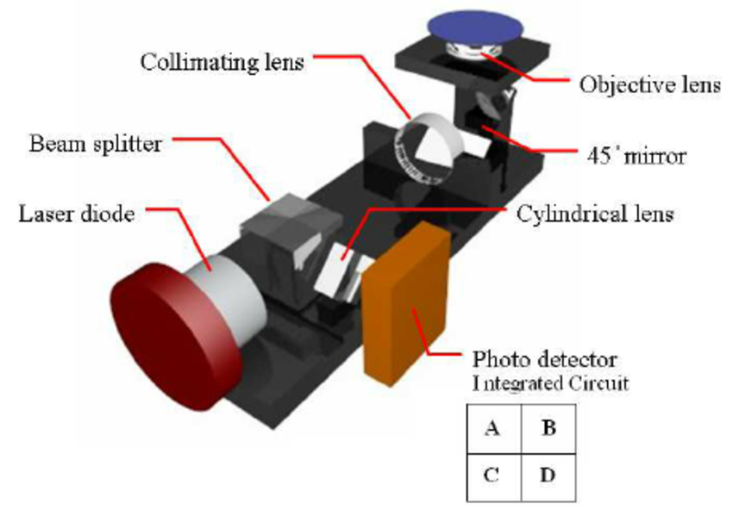
An IO Optical Disk Read head
Layout of the traditional optical pickup head

Slide 37
An IO Optical Disk Read head
Construction:
An integrated-optic optical disk pickup device capable of detecting readout and focus/tracking error signals has been designed and fabricated as shown in Fig.
The OIC was formed by depositing a planar # 7059 glass waveguide on a SiO₂ buffer layer on a silicon substrate.
The light source was a butt-coupled GaAIAs laser diode.
A chirped and curved focusing grating pattern coupler fabricated by electron beam direct writing lithography was used to focus the beam onto the disk, as well as to refocus the reflected beam back into the waveguide.
A twin-grating focusing beam splitter served to divide the reflected beam into two beams which were focused onto two pairs of photodiodes formed in the Si substrate.

Slide 38
An IO Optical Disk Read head
Operation:
The pickup head provides not only a readout signal but also focus and tracking error signals.
When the light beam is focused, the return beams hit both diodes of each pair equally.
If the readhead is too close to the disk, the beams fall more on the outer diodes, while if it is too far away they fall more on the inner diodes.
Tracking error is detected when the total intensity of the return beam reaching the left pair of diodes is not equal to that reaching the right pair.
Conventional electronic comparators, sensing the photo-currents from the diodes, can be used to develop error signals to drive position correcting actuators.

Slide 39
An IO Optical Disk Read head
Applications:
The OIC readhead of Fig, which has dimensions of only 5 × 12 mm, obviously has the advantage of being relatively insensitive to shock and vibration, as compared to a readhead fabricated from discrete optical components.
While this OIC was first proposed as an optical disk pickup device, the same basic arrangement can be used more generally as a fully integrated interferometer position/ displacement sensor with direction discrimination.
Such an interferometric sensor would be useful in a variety of high-precision positioning applications in which submicrometer accuracy is required.

Slide 40
An IO Optical Disk Read head
Further Advancements:
1. An integrated optical disk readout head has also been made by Hudgings et al.
Their device makes use of a vertical cavity surface emitting laser with an intracavity quantum well absorber.
Detection of the reflected optical signal is performed by measuring the change in absorber voltage as the optical feedback into the VCSEL cavity varies.
The head has a 0.22 V_{pp} response. Its RC time constant is 20 μs, indicating a 50 kHz rolloff frequency.
______________________________________________________________________________________
2. Manoh et al. have reported an integrated optical head device using a blue violet laser diode.
This head, which integrates seven optical elements and semiconductor chips into a 11 mm × 6 mm× 4.1 mm package, is a key device for realizing a small and thin Blu-ray Disc drive.

Slide 41
IO Wavelength Meters and Spectrum Analysers

Slide 42
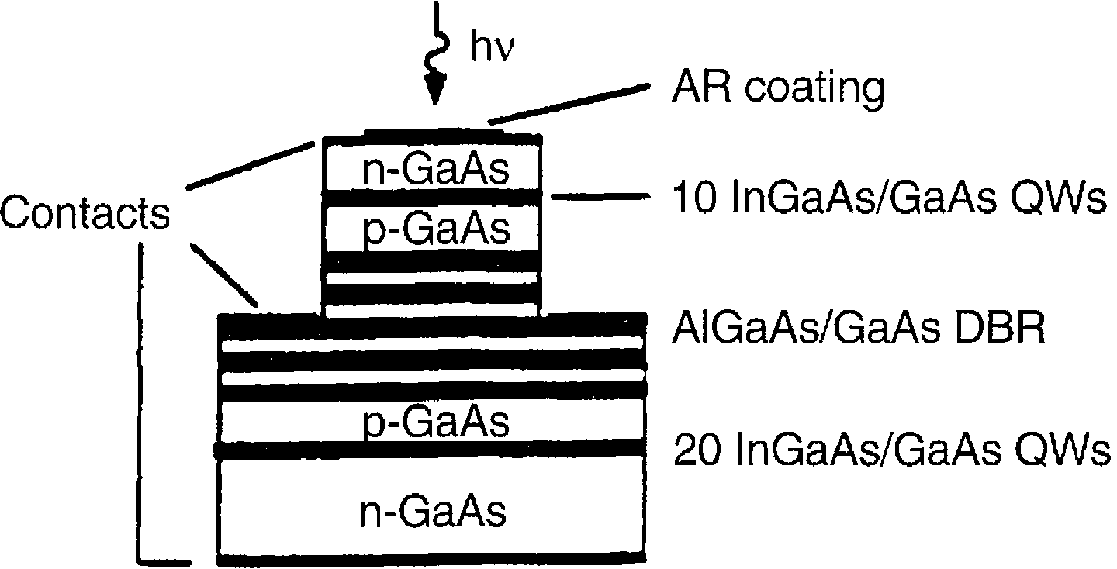
IO Wavelength Meters and Spectrum Analysers
By carefully arranging wavelength-selective optical elements in an OIC it is possible to make instruments that can measure an emission wavelength or spectrum.
For example, Nabiev et al. made a spectrophotometer that consists of two pn junction InGaAs/GaAs QW photodiodes stacked vertically with a DBR reflector between them, as shown in Fig.
The DBR reflector is composed of pairs of AlAs/GaAs.
Lightwaves entering the top surface pass through both photodiodes and are detected by them.

Slide 43
IO Wavelength Meters and Spectrum Analysers
However, because of the wavelength selective reflectance of the DBR, some of the incident light doesn’t reach the bottom photodiode.
The ratio of the top detector response to that of the bottom diode is given by:
where R0 is a constant of proportionality.
The ratio of the above equation is a single-valued function of wavelength that can be used to measure it, as shown in Fig.b, where the dotted curves are Itop and the solid curves are Ibot.

Slide 44
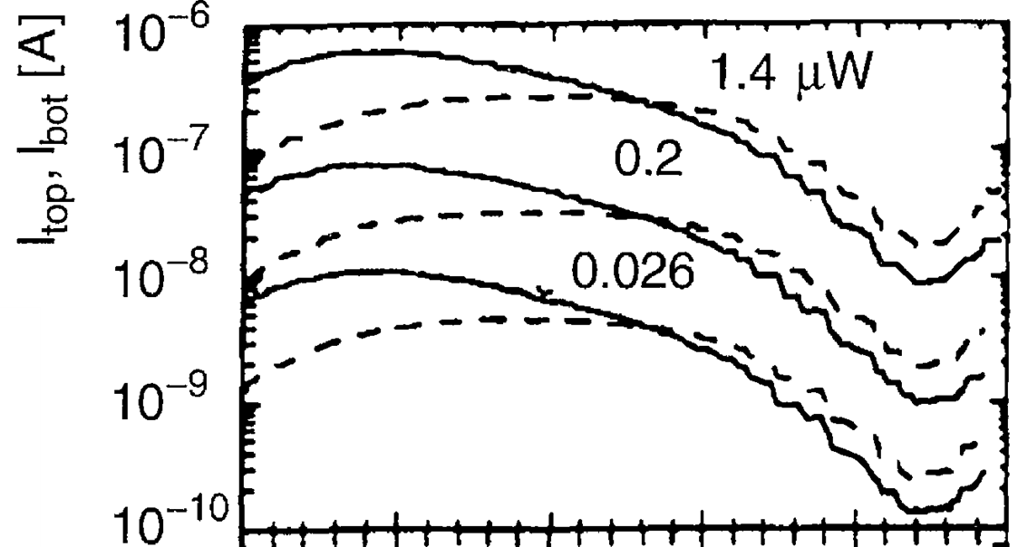
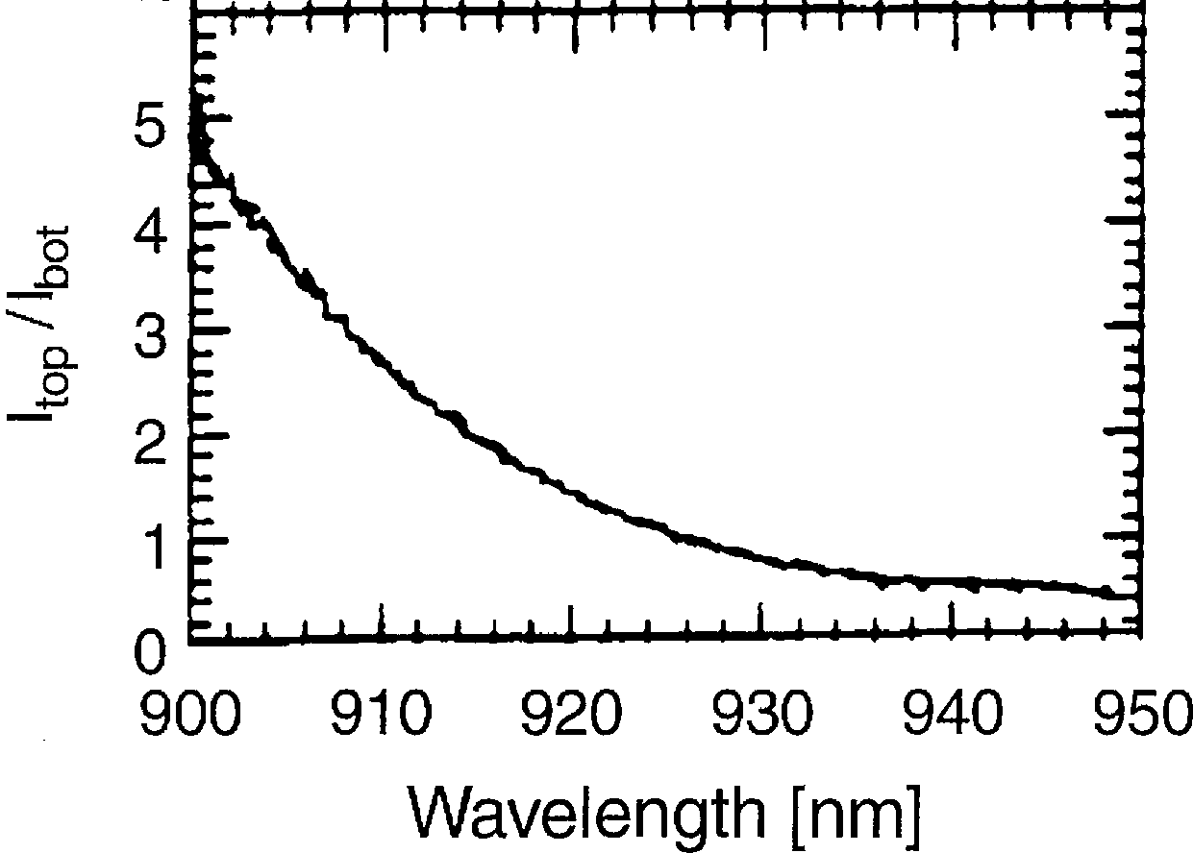
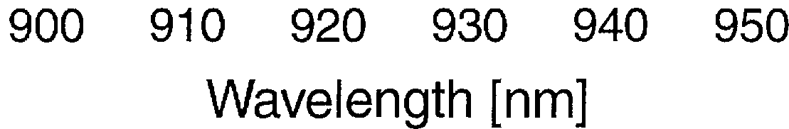
The curve in (c) is a superposition of measurements at the three optical power levels shown in (b), indicating that measured wavelength is not sensitive to optical power.

Slide 45
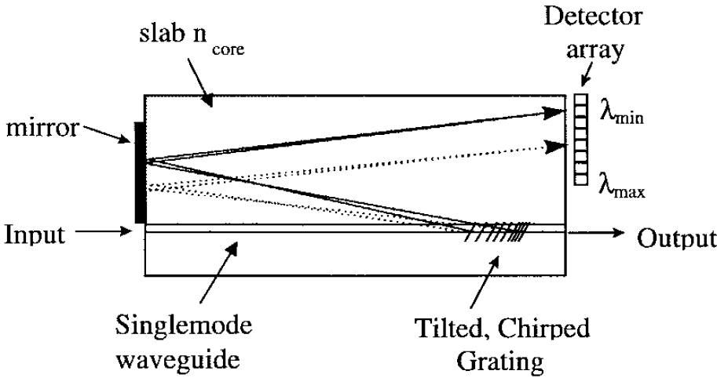
An integrated optic device also can be used to measure an optical spectrum as well as just a single wavelength.
For example, an OIC optical spectrum analyzer has been described by Madsen et al. [31].
Their device uses a tilted, chirped grating in a planar single-mode waveguide to diffract lightwaves of different wavelengths through different angles as they are coupled out of the waveguide.
The light radiated out of the waveguide is captured by a vertical slab waveguide that directs it to a linear array of photodetectors.
Each detector intercepts light of only a narrow range of wavelengths, so the optical spectrum of the light can be determined.
The fullwidth half-maximum resolution was 0.15 nm over a bandwidth range of 7.8 nm.
In this device the grating, which has a chirp of −1.75 nm/cm and a focal length of 12 cm, performs both the spatial dispersion and imaging (focusing) functions.
Schematic of the planar waveguide, UV grating based optical spectrum analyzer

Slide 46
RF Spectrum Analyzer

Slide 47
RF Spectrum Analyzer
Purpose : To enable the pilot of a military aircraft to obtain an instantaneous spectral analysis of an incoming radar beam, in order to determine if his plane is being tracked by a ground station, air-to-air missile, etc.
Such information is required if he is to be able to quickly take effective false action.
The frequency content, or signature, of all enemy radar signals that are likely to be encountered would have to be available for comparison, probably stored in the memory of the plane’s on board computer.

Slide 48
RF Spectrum Analyzer
Diagram of an integrated-optic RF spectrum analyzer

Slide 49
RF Spectrum Analyzer
Operation:
Light from a laser source is coupled into a planar waveguide, in which it passes first through a collimating lens, then through a Bragg-type acousto-optic modulator.
The rf signal to be spectrally analyzed is applied to the acoustic transducer that generates the sound waves, causing them to have a time varying period.
Thus the deflection angle of the optical beam at the output of the modulator is a function of the rf signal.
A second lens is used to focus the optical beam onto an array of photodetectors.

Slide 50
RF Spectrum Analyzer
If more than one frequency component is present in the rf signal, the light beam is divided into corresponding components that are focused onto different detector elements.
Each detector element represents a particular frequency channel, and, since photo-diodes generally have square law response, the output signal from any channel is proportional to the rf power at that frequency.
Advantage:
The advantage of an integrated optic spectrum analyzer, as compared to an electronic one, is that only a few optical elements are needed to perform a function that would otherwise require thousands of electronic elements.

Slide 51
The first working model was produced by the Westinghouse Advanced Technology Laboratories in 1980
It was fabricated on an X-cut LiNbO₃ substrate, approximately 7 × 2.5 × 0.3 cm³, in which a planar waveguide had been produced by indiffusion of titanium at 1000◦C.
The lenses used were of the geodesic variety, formed by machining dimples into the surface of the substrate prior to waveguide diffusion.
In this type of lens, light waves are still confined by the waveguide, but they follow the longer curved path through the lens region.

Slide 52
Westinghouse integrated-optic spectrum analyzer

Slide 53
Since waves traveling near the center of the lens go over a greater path length than waves traveling near its edges, the wavefront is modified, so that focusing can occur.
Such lenses can be made with surprising accuracy.
The two aspherically-corrected geodesic lenses in the Westinghouse spectrum analyzer had essentially diffraction-limited spot sizes.
The silicon diode detector array contained 140 elements, and was butt coupled to the waveguide.

Slide 54
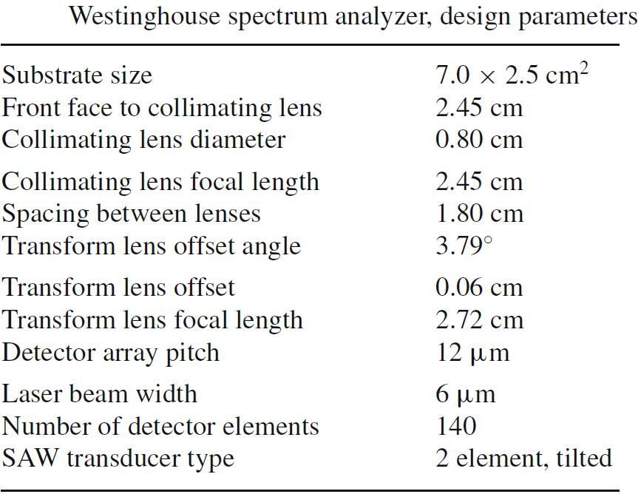
Design parameters for the Westinghouse integrated-optic spectrum analyzer are

Slide 55
The input lens focal length was chosen to expands a 6 μm GaAlAs laser spot to 2 mm by diffraction.
The spectrum analyzer was tested first with a He-Ne laser source of 632.8 nm wavelength and found to have a bandwidth of 400 MHz with a resolution of 5.3 MHz.
Later results obtained by using a butt-coupled GaAlAs laser diode emitting at 830 nm as the source showed an improved resolution of 4 MHz.

Slide 56
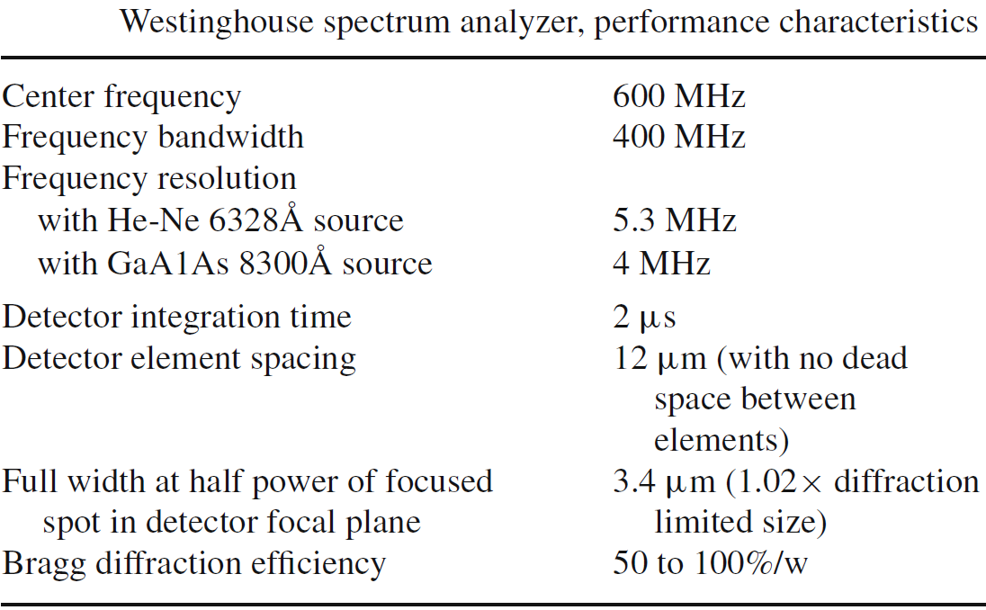
The performance characteristics are given in Table

Slide 57
The 400 MHz bandwidth limitation is mostly caused by the acoustic transducer, and may be improved by using a more sophisticated transducer.
In any case, the spectrum analyzer could be used over a wider frequency range by using a local oscillator and mixer at the input to the transducer
Thus, heterodyning could be used to electronically shift the 400 MHz band pass to various center frequencies as desired.

